Slide 1
AZ-400.00 Learning Path 02: Implement CI with Azure Pipelines and GitHub Actions

Slide 2
Agenda
Module 01: Explore Azure Pipelines.
Module 02: Design and implement a pipeline strategy.
Module 03: Integrate with Azure Pipelines.
Module 04: Introduction to GitHub Actions.
Module 05: Identify technical debt.
Module 06: Design a container build strategy.
Labs.

Slide 3
Module 01: Explore Azure Pipelines

Slide 4
Explore the concept of pipelines in DevOps
Build automation and continuous integration
Test automation
Deployment automation
A pipeline enables a constant flow of changes into production via an automated software production line
Pipelines create a repeatable, reliable and incrementally improving process for taking software from concept to customer
Pipelines require infrastructure, this infrastructure will have a direct impact on the effectiveness of the pipeline

Slide 5
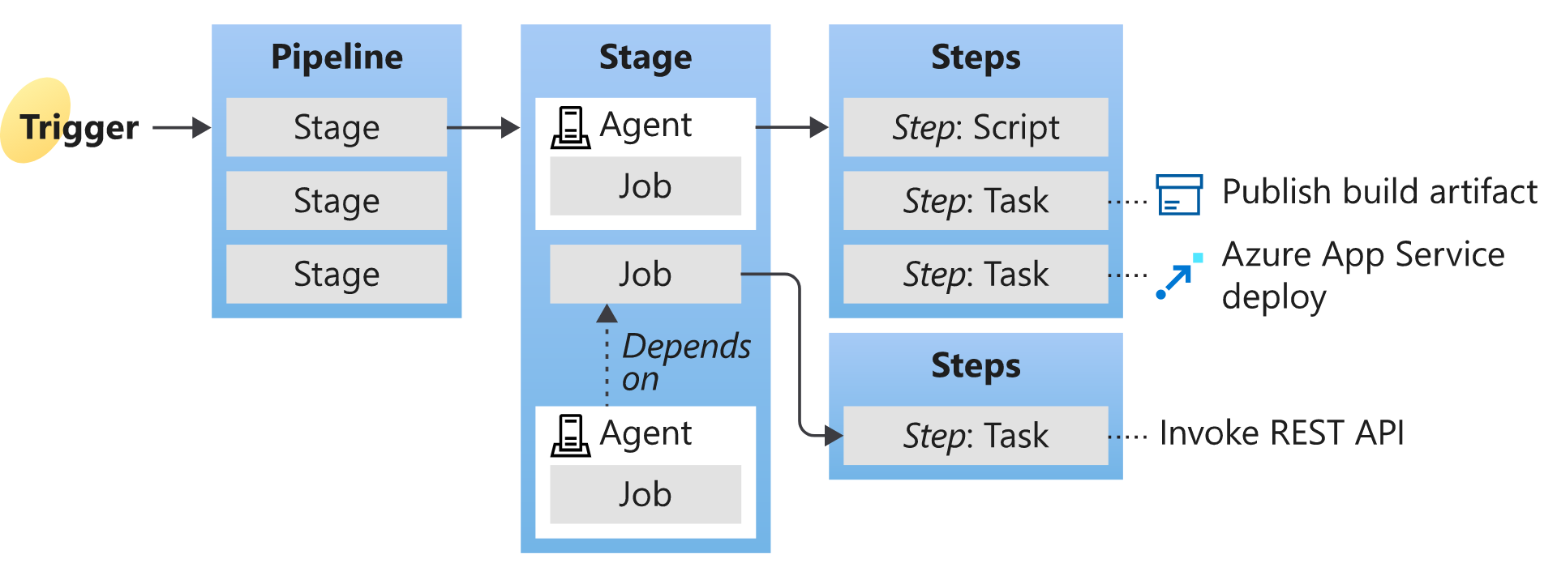
Understand Azure Pipelines key terms
Continuous Delivery (CD)
Continuous Integration (CI)
Deployment target
Notes:
Give a brief description and explain the terms to introduce students to what comes next in the course. We will cover in deeper details in the next Learning Paths.
Understanding the basic terms and parts of Azure Pipelines helps you further explore how it can help you deliver better code more efficiently and reliably.
Agent
When your build or deployment runs, the system begins one or more jobs. An agent is an installable software that runs a build or deployment job.
Artifact
An artifact is a collection of files or packages published by a build. Artifacts are made available for next tasks, such as distribution or deployment.
Build
A build represents one execution of a pipeline. It collects the logs associated with running the steps and the results of running tests.
Continuous delivery
Continuous delivery (CD) (also known as Continuous Deployment) is a process by which code is built, tested, and deployed to one or more test and production stages. Deploying and testing in multiple stages helps drive quality. Continuous integration systems produce deployable artifacts, which include infrastructure and apps. Automated release pipelines consume these artifacts to release new versions and fixes to existing systems. Monitoring and alerting systems constantly run to drive visibility into the entire CD process. This process ensures that errors are caught often and early.
Continuous integration
Continuous integration (CI) is the practice used by development teams to simplify the testing and building of code. CI helps to catch bugs or problems early in the development cycle, making them more accessible and faster to fix. Automated tests and builds are run as part of the CI process. The process can run on a set schedule, whenever code is pushed, or both. Items known as artifacts are produced from CI systems. The continuous delivery release pipelines use them to drive automatic deployments.
Deployment target
A deployment target is a virtual machine, container, web app, or any service used to host the application being developed. A pipeline might deploy the app to one or more deployment targets after the build is completed and tests are run.
Job
A build contains one or more jobs. Most jobs run on an agent. A job represents an execution boundary of a set of steps. All the steps run together on the same agent.
For example, you might build two configurations - x86 and x64. In this case, you have one build and two jobs.
Pipeline
A pipeline defines the continuous integration and deployment process for your app. It's made up of steps called tasks.
It can be thought of as a script that describes how your test, build, and deployment steps are run.
Release
When you use the visual designer, you create a release pipeline also to a build pipeline. A release is a term used to describe one execution of a release pipeline. It's made up of deployments to multiple stages.
Stage
Stages are the primary divisions in a pipeline: "build the app," "run integration tests," and "deploy to user acceptance testing" are good examples of stages.
Task
A task is the building block of a pipeline. For example, a build pipeline might consist of build tasks and test tasks. A release pipeline consists of deployment tasks. Each task runs a specific job in the pipeline.
Trigger
A trigger is something that's set up to tell the pipeline when to run. You can configure a pipeline to run upon a push to a repository at scheduled times or upon completing another build. All these actions are known as triggers.

Slide 6
Choose between Microsoft-hosted versus self-hosted agents
You generally need at least one agent to build or deploy your project.
An agent is installable software that runs one build or deployment job at a time.
Two types of agents:
1
Microsoft-hosted agents – Maintenance and upgrades are automatically done. Each time a pipeline is run, a fresh virtual machine (instance) is provided. There are time limits on jobs running on these agents.
2
Self-hosted agents – You take care of maintenance and upgrades. Give you more control to install dependent software needed. Can be installed on Linux, macOS, Windows machines, or in a Linux Docker container. There are no time limits on jobs running on these agents.

Slide 7
Explore job types
Four types of jobs:
1
Agent pool jobs – Jobs that run on an agent in an agent pool
2
Container jobs – Jobs that run in a container on an agent in an agent pool
3
Deployment group jobs – Jobs that run on systems in a deployment group
4
Agentless jobs – Jobs that run on the Azure DevOps server (also called Server Jobs)

Slide 8
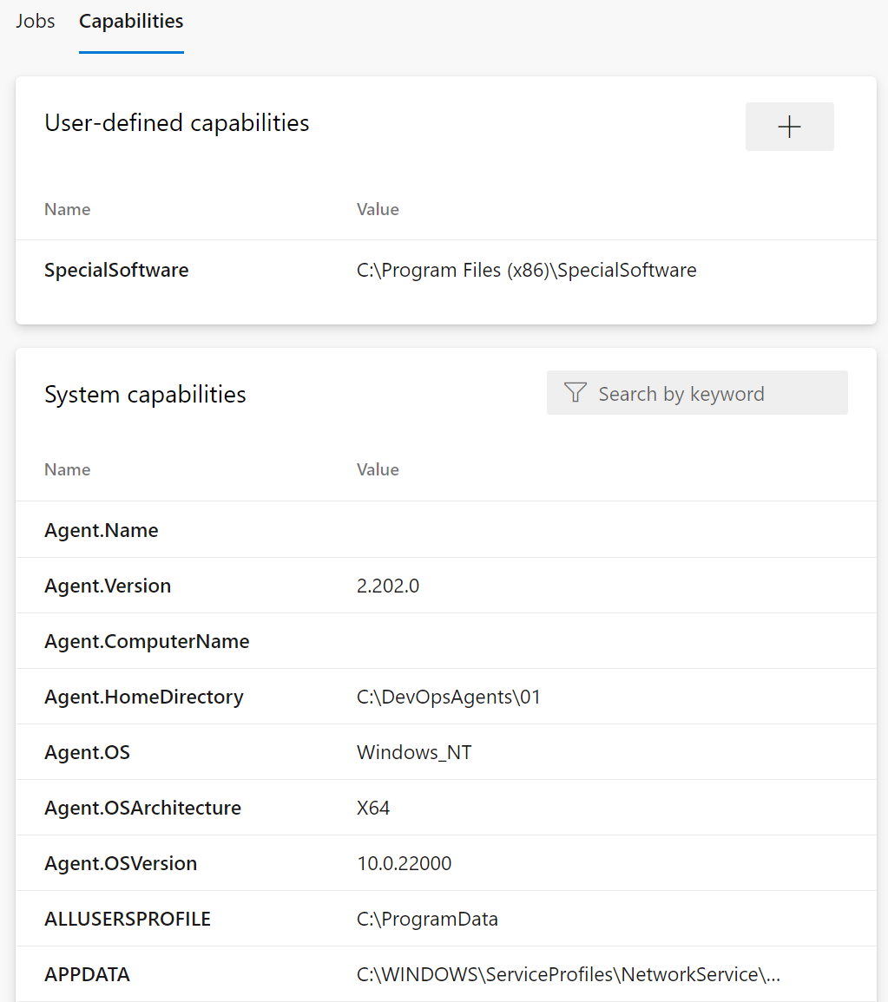
Configure agent demands
User-defined capabilities
System capabilities
Agents can have different authorization and timeout settings.
Notes:
For more information, you can see: Capabilities - https://docs.microsoft.com/azure/devops/pipelines/agents/agents

Slide 9
Introduction to agent pools
Pool A
Pool B
Machine
Machine
Agent
Agent
Agent
Agent
Agent
You can organize agents into agent pools.
An agent pool defines the sharing boundary.
In Azure Pipelines, agent pools are scoped to the Azure DevOps organization; so, you can share an agent pool across projects.
Notes:
Use the student manual for some typical situations where you might want to create agent pools.

Slide 10
Explore predefined agent pool
Image | Purpose | YAML VM Image Label
Windows Server 2022 with Visual Studio 2022 | Windows-2022 | Windows-latest OR windows-2022
Windows Server 2019 with Visual Studio 2019 | Windows-2019 | Windows-2019
Ubuntu 22.04 | Ubuntu-22.04 | Ubuntu-latest OR ubuntu-22.04
Ubuntu 20.04 | Ubuntu-20.04 | Ubuntu-20.04
macOS 14 Sonoma | MacOS-14 | macOS-14
macOS 13 Ventura | MacOS-13 | macOS-13
Notes:
Explain that the list constantly updates; the latest versions should be checked directly from the documentation.
https://learn.microsoft.com/azure/devops/pipelines/agents/hosted
https://learn.microsoft.com/azure/devops/pipelines/agents/agents

Slide 11
Understand typical situations for agent pools
You’re a member of a project and you want to use a set of machines owned by your team for running build and deployment jobs.
You’re a member of the infrastructure team and would like to set up a pool of agents for use in all projects.
You want to share a set of agent machines with multiple projects but not all of them.
Pool A
Pool B
Machine
Machine
Agent
Agent
Agent
Agent
Agent
Queue 1
Queue 2
Queue 1
Team Project Collection A
Team Project Collection B
Team Project A1
Team Project A2
Team Project B1
Job 1
Job 3
Job 1
Job 2
Job 4
Job 2

Slide 12
Communicate with Azure Pipelines
The agent determines which job it needs to run, report the logs, and job status.
Communication is always initiated by the agent.
All the messages from the agent to Azure Pipelines are over HTTPS.
Azure Pipelines
Port 443
Agent on an on-premises machine behind firewall
Agent on a machine in cloud

Slide 13
Communicate to deploy to target servers
Agent must have “line of sight” connectivity to servers.
Microsoft-hosted agent pools, by default, have connectivity to Azure websites and servers running in Azure.
You may need to manually configure connectivity.
Azure Pipelines service
Agent pools
Microsoft-hosted agents
Default
Hosted
1
2
3
4
Network firewall
X
No Line of Sight
Self-hosted agents
Target on-premises stages
1
2
3
4
Server1
Server2
Server3
Server4
Has line of sight, and so can deploy artifacts to these servers

Slide 14
Understand parallel jobs
eShopOnWeb CI Build 102 (main)
1
eShopOnWeb Release 11
2
5
eShopOnWeb CI Build 101 (feature)
3
4
Queued build waiting for pipeline
Build running
Release waiting for pipeline
Release running
Release waiting for approval
This is a simple example of a Microsoft-hosted parallel job.
Users can collectively run only one build or release job at a time; additional jobs are queued.
A release consumes a parallel job only when it’s being actively deployed to a stage.

Slide 15
Module 02: Integrate with Azure Pipelines

Slide 16
Describe the anatomy of a pipeline
1
Name – Though often this is skipped (if it is skipped, a date-based name is generated automatically)
2
Trigger – More on triggers later, but without an explicitly trigger, there’s an implicit “trigger on every commit to any path from any branch in this repo”
3
Variables – These are “inline” variables (more on other types of variables later)
4
Job – Every pipeline must have at least one job
5
Pool – You configure which pool (queue) the job must run on
6
Checkout – The “checkout: Self” tells the job which repository (or repositories if there are multiple checkouts) to checkout for this job
7
Steps – The actual tasks that need to be executed: in this case a “script” task (script is an alias) that can run inline scripts

Slide 17
Understand the pipeline structure
1
Pipeline – One or more stages that describe a CI/CD process
2
Stage – Collection of related jobs
3
Job – Collection of steps run by an agent on a server
4
Step – Linear sequence of operations that make up a job
5
Tasks – Building blocks of a pipeline
Notes:
In case you want to review the pipeline structure.

Slide 18
Detail YAML templates
Azure Pipelines supports 4 kinds of templates:
1
Stage
2
Job
3
Step
4
Variable

Slide 19
Explore YAML resources
resources:
pipelines: [ pipeline ]
repositories: [ repository ]
containers: [ container ]
Pipelines
Repositories
Containers
resources:
pipelines:
- pipeline: MyAppA
source: MyCIPipelineA
- pipeline: MyAppB
source: MyCIPipelineB
trigger: true
- pipeline: MyAppC
source: MyCIPipelineC
branch: releases/M174
version: 20230709.2
trigger:
branches:
include:
- main
- releases/*
exclude:
- users/*

Slide 20
Migrate a pipeline from classic to YAML in Azure Pipelines
Feature | Key Considerations | Limitations
Export to YAML | For build pipelines. Support for most tasks, triggers, jobs and options | Does not include variables and time zone translation
View YAML | For release pipelines. Can generate the YAML code for individual tasks, which can be used to create the YAML pipeline | The code does not include values of the individual task properties but substitutes them with variables
Task Assistant | Helps with creating and modifying YAML steps by providing a graphical interface, autocomplete suggestions, inline documentation, validation, and marketplace integration | N/A

Slide 21
Module 03: Introduction to GitHub Actions

Slide 22
What are Actions?
1
Automations within the GitHub environment
2
Often used to build CI/CD implementations
3
Based on YAML files living within GitHub repositories
4
Executed on GitHub or self-hosted runners
5
Large number of existing actions in the GitHub Marketplace

Slide 23
Explore Actions flow
Events
Events trigger workflows:
Schedule, code, etc.
Trigger
Workflows
Workflows contain jobs:
May contain multiples
Contain
Jobs use actions:
Configured within steps
Jobs
Use
Actions

Slide 24
Understand Workflows
# .github/workflows/build.yml
name: Node Build
on: push
jobs:
mainbuild:
runs-on: ${{ matrix.os }}
strategy:
matrix:
node-version: [12.x]
os: [windows-latest]
steps:
- uses: actions/checkout@v1
- name: Run node.js on latest Windows
uses: actions/setup-node@v1
with:
node-version: ${{ matrix.node-version }}
- name: Install NPM and build
run: |
npm ci
npm run build
Define the required automation:
Events, Jobs
Written in YAML
Stored in .github/workflows
Starter workflows available

Slide 25
Describe standard workflow syntax elements
1
Name: The name of the workflow (optional but recommended)
2
On: The event that triggers the workflow
3
Jobs: The list of jobs to be executed
4
Runs-on: The target runner
5
Steps: The list of steps to execute
6
Uses: A predefined action to retrieve
7
Run: Tells the job to execute a command on the runner

Slide 26
Explore Events
on:
schedule:
- cron: '0 8-17 * * 1-5'
Defined by the on clause
on:
pull_request
Scheduled events
Code events
Manual events
Webhook events
External events
on:
[push, pull_request]
on:
pull_request:
branches:
- develop
on:
gollum

Slide 27
Explore Jobs
jobs:
startup:
runs-on: ubuntu-latest
steps:
- run: ./setup_server_configuration.sh
build:
steps:
- run: ./build_new_server.sh
jobs:
startup:
runs-on: ubuntu-latest
steps:
- run: ./setup_server_configuration.sh
build:
needs: startup
steps:
- run: ./build_new_server.sh
Workflows contain one or more jobs. Jobs contain a set of steps to execute in order.
Jobs run in parallel by default but can be configured with dependencies.

Slide 28
Explore Runners
Job steps execute on runners:
Shell scripts
Actions
For JavaScript code, Node.js hosted runners:
Windows
MacOS
Linux
For other languages or options:
Docker containers on Linux
Self-hosted – but do not use for public repos

Slide 29
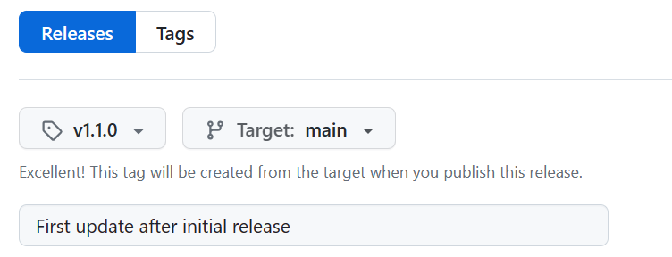
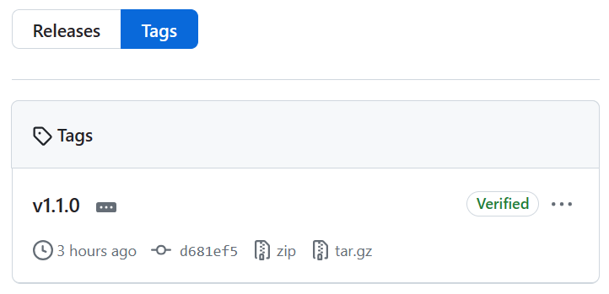
Mark releases with Git tags
Releases are based on Git tags
Mark a specific point in repository history
Tags are viewed in the repository history

Slide 30
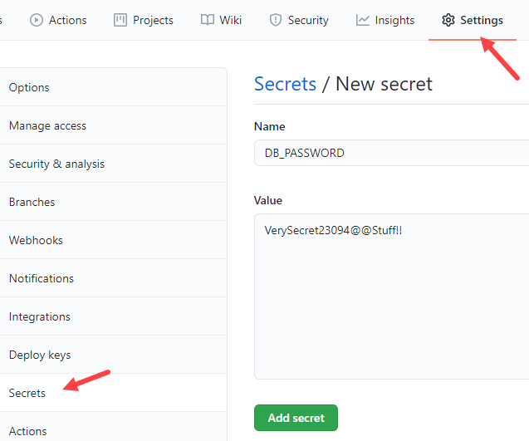
Create encrypted secrets
Like environment variable but encrypted
Created at repository or organization level
Created/assigned in the GitHub UI

Slide 31
Use secrets in a workflow
steps: actions/upload-artifact
- name: Test Database Connectivity
with:
db_username: ${{ secrets.DBUserName }}
db_password: ${{ secrets.DBPassword }}
Secrets not automatically passed to runners
Can be passed as inputs or as environment variables
Avoid passing secrets in command-line arguments
steps:
- shell: pwsh
env:
DB_PASSWORD: ${{ secrets. DBPassword }}
run: | db_test "$env.DB_PASSWORD"

Slide 32
Module 04: Identify technical debt

Slide 33
Examine code quality
Short deadlines, a lack of coding standards, and poor technical skills can lead to code that is NOT:
1
4
Clear and readable
Maintainable
2
5
Documented
Extensible
3
6
Efficient
Secure

Slide 34
Examine complexity and quality metrics
A few of the most important complexity-related metrics:
1
Program vocabulary
2
Calculated program length
3
Volume
4
Difficulty
5
Effort

Slide 35
Introduction to technical debt
Technical Debt describes the future penalty that you incur today by making easy or quick choices in software development practices.

Slide 36
Measure and manage technical debt
1
Failed builds percentage
2
Failed deployments percentage
3
Ticket volume
4
Bug bounce percentage
5
Unplanned work percentage

Slide 37
Sources and impacts of technical debt
Common sources of technical debt are:
Lack of coding style and standards.
Lack of or poor design of unit test cases.
Ignoring or not understanding object design principles.
Monolithic classes and code libraries.
Poorly envisioned use of technology, architecture and approach.
Over-engineering code.
Insufficient comments and documentation.
Not writing self-documenting code.
Taking shortcuts to meet deadlines.
Leaving dead code in place.

Slide 38

Using automated testing to measure technical debt
Technical debt:
1
Adds problems during development that makes it more difficult to add customer value
2
Saps productivity and frustrates development teams
3
Makes code both hard to understand and fragile
4
Increases the time to make changes, and to validate those changes
5
Starts small and grows over time
One way to minimize the accumulation of technical debt, is to use automated testing and assessment

Slide 39
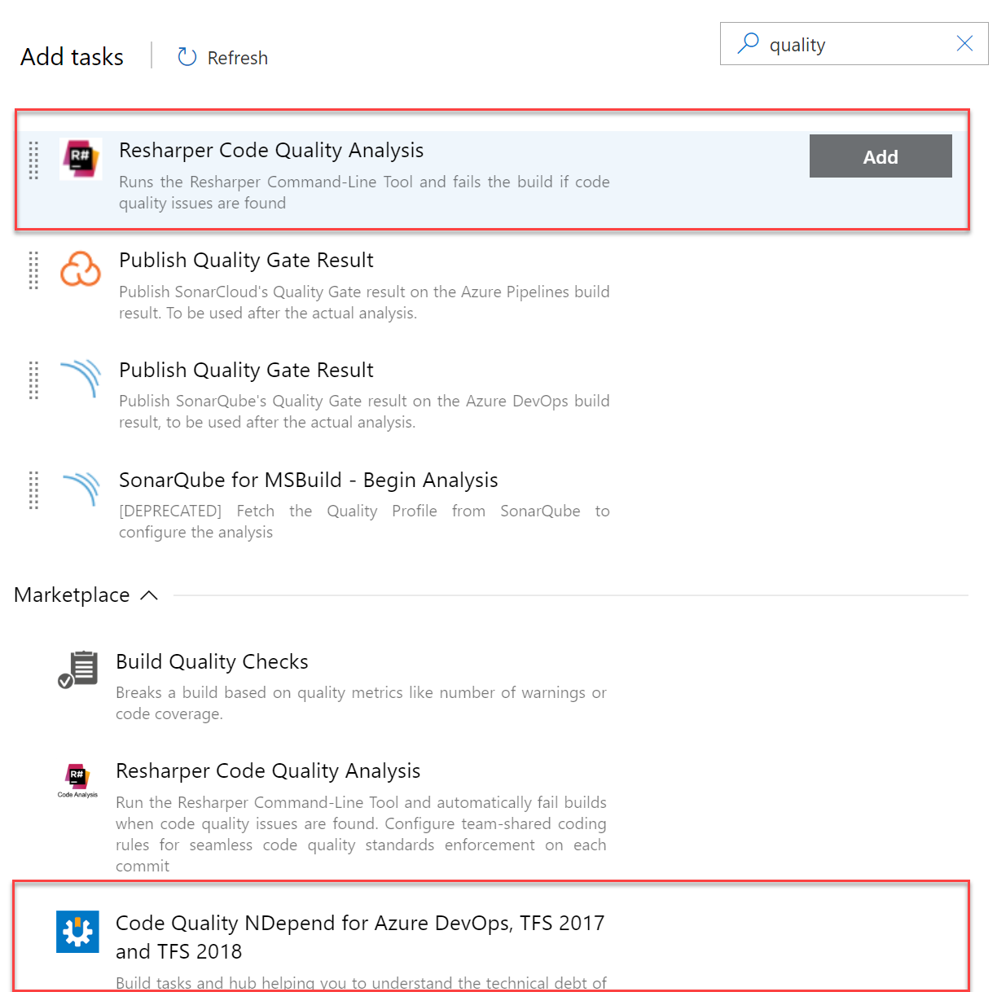
Integrate other code quality tools
NDepend is a Visual Studio extension that assesses the amount of technical debt that a developer has added during a recent development period, typically in the last hour.
Resharper Code Quality Analysis is a command line tool and can be set to automatically fail builds when code quality issues are found.
Notes:
For more information, you can see:
NDepend - https://www.ndepend.com
Visual Studio marketplace - https://marketplace.visualstudio.com/items?itemName=ndepend.ndependextension&targetId=2ec491f3-0a97-4e53-bfef-20bf80c7e1ea
Resharper Code Quality Analysis - https://marketplace.visualstudio.com/items?itemName=alanwales.resharper-code-analysis

Slide 40
Plan effective code reviews
1
Everyone is trying to achieve better code quality
2
Knowledge sharing

Slide 41
Module 05: Design a container build strategy

Slide 42
Why Containers?
1
Portable – Run containers wherever Docker is supported
2
Consistent – Know that developers are working with identical code
3
Lightweight – Far less disk, CPU, and memory than VMs
4
Efficient – Fast deployment, booting, patching, updates

Slide 43
Examine structure of containers
VM1 Apps OS
VM2 Apps OS
VM3 Apps OS
C1 Apps
C2 Apps
C3 Apps
C4 Apps
C5 Apps
C6 Apps
Hypervisor
Container Engine
Host Operating System
Host Operating System
Server Hardware
Server Hardware

Slide 44
Labs

Slide 45
Lab: Configuring Agent Pools and Understanding Pipeline Styles
Objectives:
Implement YAML-based pipelines
Implement self-hosted agents
Lab overview:
In this lab, you will step through the process of converting a classic pipeline into a YAML-based one and running it first by using a Microsoft-hosted agent and then performing the equivalent task by using a self-hosted agent.
Duration:
Notes:
The labs are updated on a regular basis. For the latest information please visit:
https://microsoftlearning.github.io/AZ400-DesigningandImplementingMicrosoftDevOpsSolutions/

Slide 46
Lab: Enabling continuous integration with Azure Pipelines
Objectives:
Create a basic build pipeline from a template
Track and review a build
Invoke a continuous integration build
Lab overview:
In this lab, you will learn how to configure continuous integration (CI) and continuous deployment (CD) for your applications using Build and Release in Azure Pipelines.
Duration:
Notes:
The labs are updated on a regular basis. For the latest information please visit:
https://microsoftlearning.github.io/AZ400-DesigningandImplementingMicrosoftDevOpsSolutions/

Slide 47
Lab: Implementing GitHub Actions for CI/CD
Objectives:
Implement a GitHub Action workflow by using DevOps Starter
Explain the basic characteristics of GitHub Action workflows
Lab overview:
In this lab, you will learn how to implement a GitHub Action workflow that deploys an Azure web app by using DevOps Starter.
Duration:
Notes:
The labs are updated on a regular basis. For the latest information please visit:
https://microsoftlearning.github.io/AZ400-DesigningandImplementingMicrosoftDevOpsSolutions/

Slide 48
Lab: Deploying Docker containers to Azure App Service web apps
Objectives:
Build a custom Docker image by using a Microsoft hosted Linux agent
Push an image to Azure Container Registry
Deploy a Docker image as a container to Azure App Service by using Azure DevOps
Lab overview:
In this lab, you will learn how to use an Azure DevOps CI/CD pipeline to build a custom Docker image, push it to Azure Container Registry, and deploy it as a container to Azure App Service.
Duration:
Notes:
The labs are updated on a regular basis. For the latest information please visit:
https://microsoftlearning.github.io/AZ400-DesigningandImplementingMicrosoftDevOpsSolutions/

Slide 49
Closing slide

